Slide 1
2.151 Final Project
Lucille Hosford, Chris Welch, Brian Wilcox, Manjinder Singh

Slide 2
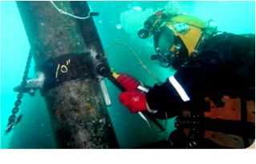
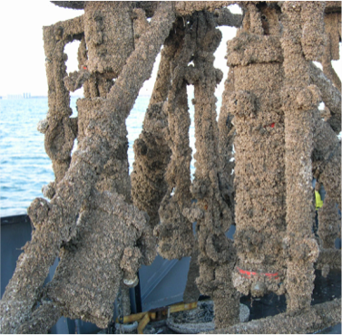
Impedance Control in the Oil and Gas Industry
Decommissioning is the dismantling of offshore structures
Current state of practices uses ROVs and divers
ROVs = Very expensive operational costs
Divers = Very significant safety risks
Replace with autonomy?
Autonomous decommissioning vehicles must demonstrate comparable ability to sense and manipulate
Key tasks include scrubbing biofouling and testing valve functionality
Suggests impedance control!

Slide 3
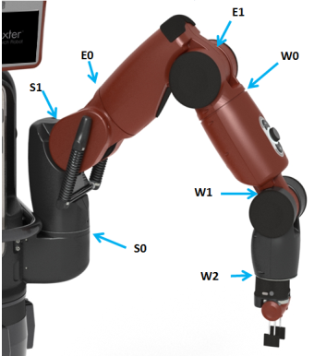
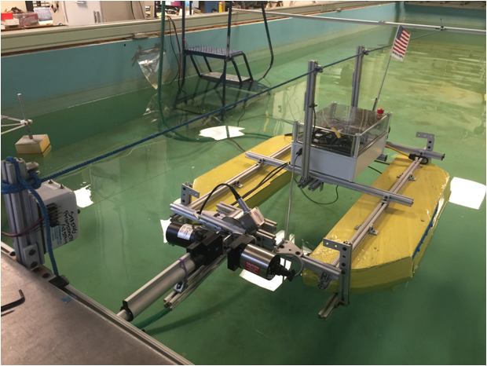
Baxter and Dexter
Long term goal: Dexter affords ability to investigate free-flight collisions, but Baxter’s manipulator more realistically exemplifies desired dexterity of a light intervention AUV
Use Dexter’s linear actuator to find range of impedances for acceptable collision characteristics
Demonstrate that Baxter’s multi dof arm can reproduce those impedances

Slide 4
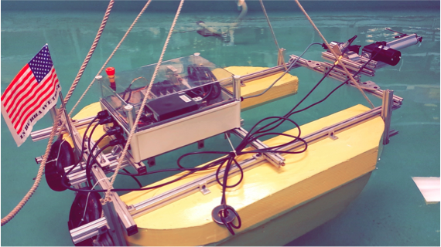
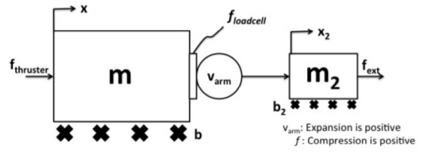
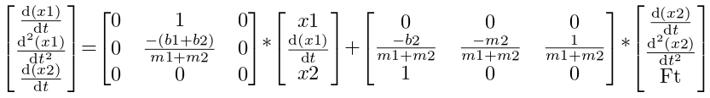
Dexter State Space Representation: Open Loop Model
State Space Representation

Slide 5
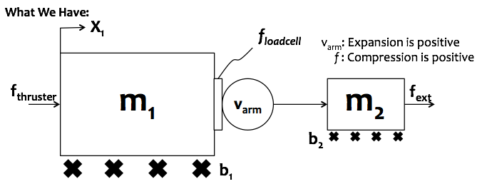
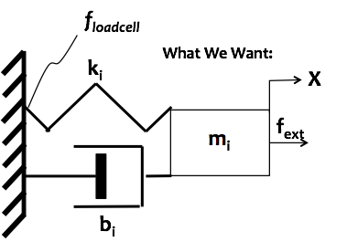
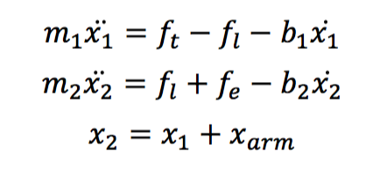
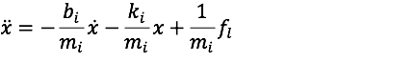
Dexter Equations of Motion: Closed Loop Model

Slide 6
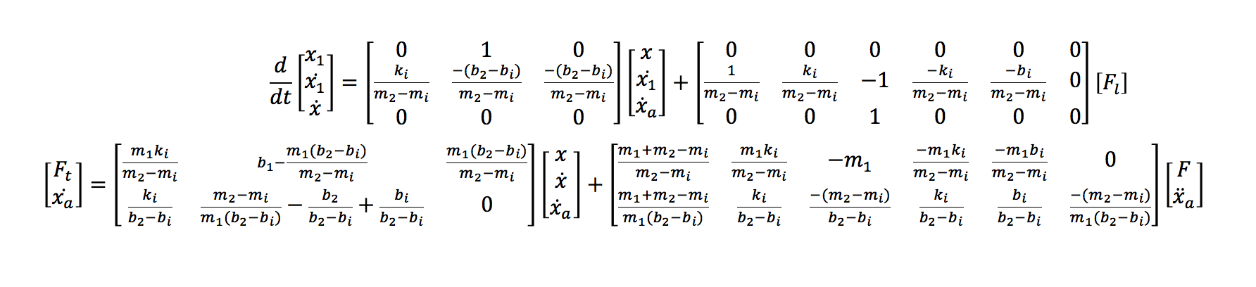
Dexter State Space Representation: Closed Loop Model
The above state space model describes necessary actuation with respect to sensor inputs in order to achieve a desirable, user-defined endpoint impedance
However, focus for Baxter is on the actuator’s impedance characteristics

Slide 7
2.151 Final Project
Lucille Hosford, Chris Welch, Brian Wilcox, Manjinder Singh

Slide 8
Impedance Control in the Oil and Gas Industry
Decommissioning is the dismantling of offshore structures
Current state of practices uses ROVs and divers
ROVs = Very expensive operational costs
Divers = Very significant safety risks
Replace with autonomy?
Autonomous decommissioning vehicles must demonstrate comparable ability to sense and manipulate
Key tasks include scrubbing biofouling and testing valve functionality
Suggests impedance control!

Slide 9
Baxter and Dexter
Long term goal: Dexter affords ability to investigate free-flight collisions, but Baxter’s manipulator more realistically exemplifies desired dexterity of a light intervention AUV
Use Dexter’s linear actuator to find range of impedances for acceptable collision characteristics
Demonstrate that Baxter’s multi dof arm can reproduce those impedances

Slide 10
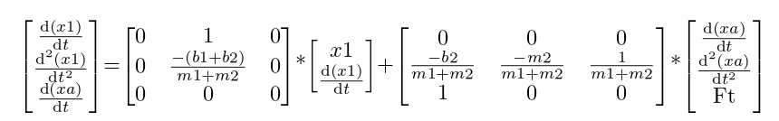
Dexter State Space Representation: Open Loop Model
State Space Representation

Slide 11
Dexter Equations of Motion: Closed Loop Model

Slide 12
Dexter State Space Representation: Closed Loop Model
The above state space model describes necessary actuation with respect to sensor inputs in order to achieve a desirable, user-defined endpoint impedance
However, focus for Baxter is on the actuator’s impedance characteristics

Slide 13
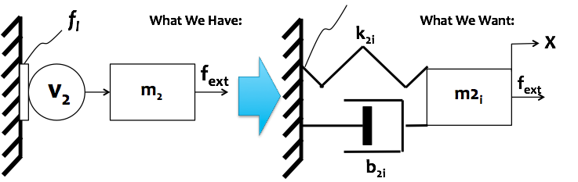
Turning a Non-Backdrivable Linear Actuator Into a Passive System
Creating a controller for the linear actuator based desired impedance parameters allows for:
A closed-loop system that promotes robust and stable interactions due to passivity
Achievable design constraints (e.g., Peak impact force, Settling time)
Definitive impedance values for Baxter to reproduce

Slide 14
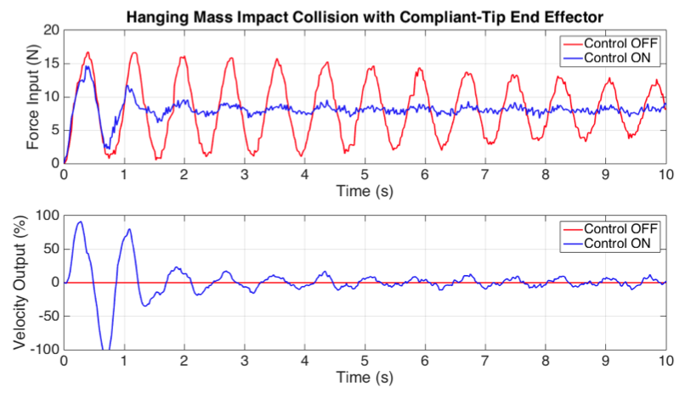
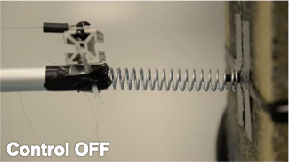
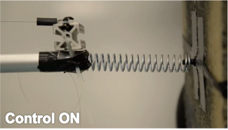
Determining Desirable Impedance Characteristics
A reduction in peak force provides a buffer for a controller to react to any unforeseen collisions
Alleviates significant risks for valuable equipment on hard-to-reach AUVs
A sharp reduction in settling time suggests a smaller influence by external disturbances, such as underwater currents
Minimizes unpredictable disturbances during any on going contact tasks
Feed impedance values to Baxter!

Slide 15
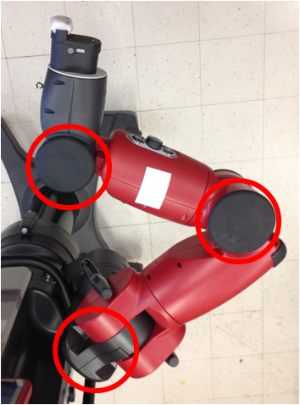
Baxter Research Robot
For the purposes of the experiment, Baxter was constrained to planar motion by only allowing joints S1, E1, and W1 to move.

Slide 16
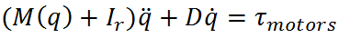
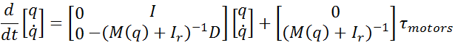
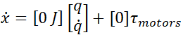
Baxter Research Robot: Open loop model
Neglecting SEA dynamics, Equations of Motion
Simplifies to
State space representation

Slide 17
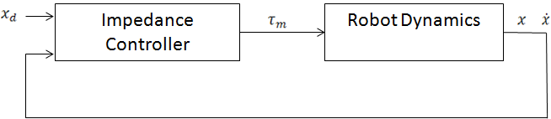
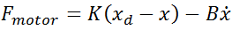
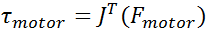
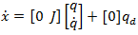
Baxter Research Robot: Closed loop model

Slide 18
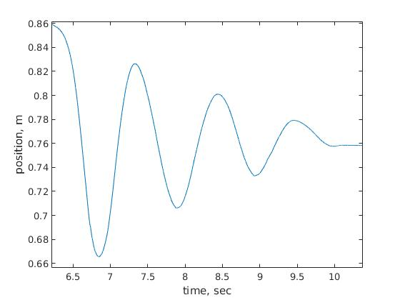
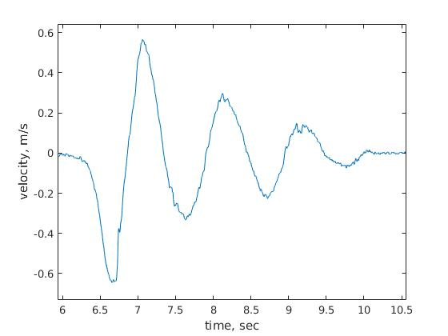
Baxter Research Robot: Real Data

Slide 19
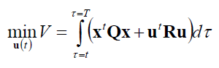
Baxter Research Robot: LQR Design
What if we want to specify performance criteria for the states?
Max actuator force
Stroke Length
Use LQR to optimize performance and control effort

Slide 20
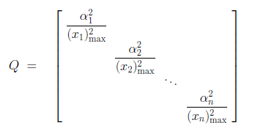
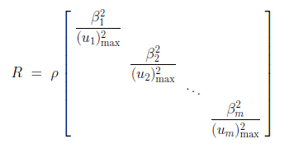
Baxter Research Robot: LQR Design
Bryson’s Rule
Baxter system criteria:
x1max (x position) = 0.5214 m
u1max (shoulder torque) = 50 Nm
u2max(elbow torque) = 15 Nm
u3max(wrist torque) = 15 Nm

Slide 21
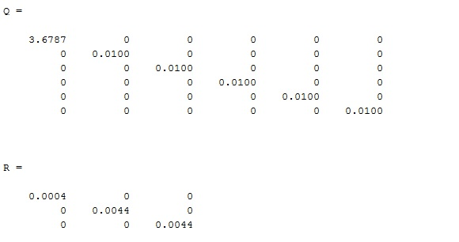
Baxter Research Robot: LQR Design
Expensive vs Cheap Control
p = 1 (equal weighting)
p = 1e6 (expensive control)
p = 1e-6 (cheap control)

Slide 22
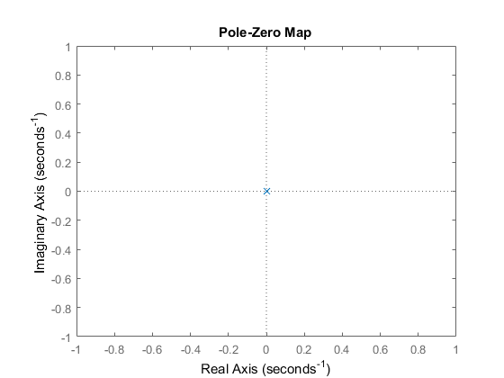
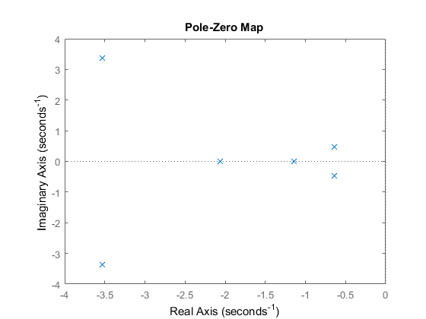
Baxter Research Robot: LQR Design
Open-Loop
Closed Loop: Equal Weighting

Slide 23
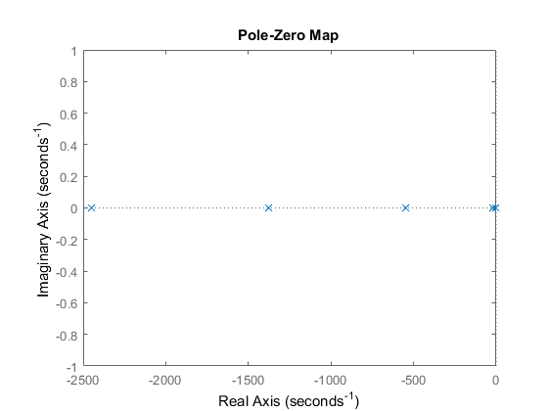
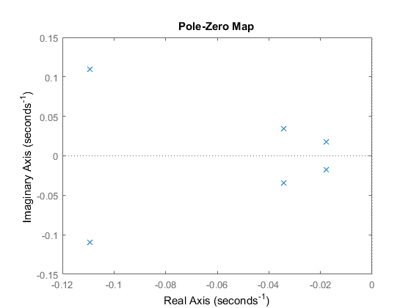
Baxter Research Robot: LQR Design
Closed Loop: Expensive
Closed Loop: Cheap

Slide 24
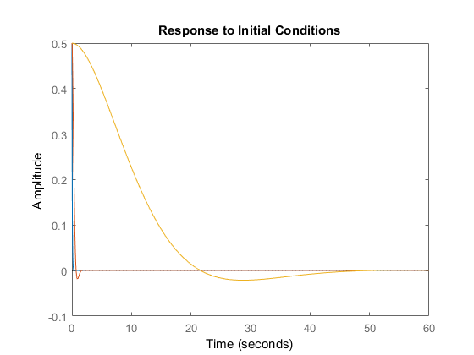
Baxter Research Robot: LQR Design
blue - cheap
orange - expensive
yellow - equal

Slide 25
Baxter Research Robot: LQR Discussion
Expensive control is realistic given good performance results and less control (actuator effort)
Choosing relative weighting of states/inputs may be significant
Can we design performance criteria around impact collision response?
Can we combine impedance into cost function for LQR design?

Slide 26
Dexter LQR Design
Criteria:
Max Thrust=10 Nm
Max Stroke length=10 in
Different Designs:
Cheap
Expensive
Equal
Weighting xa vs x1

Slide 27
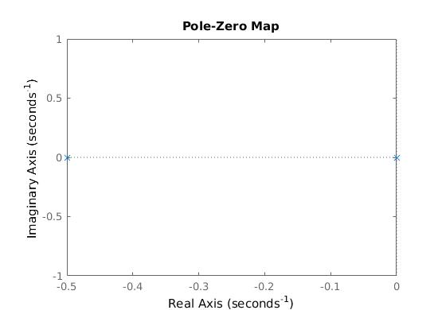
Dexter LQR Design
Open-Loop

Slide 28
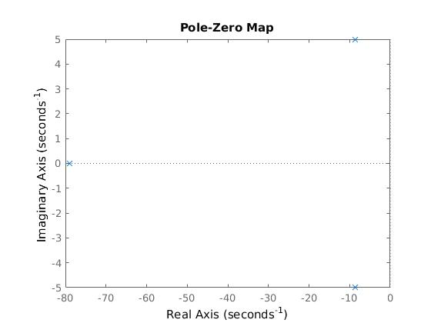
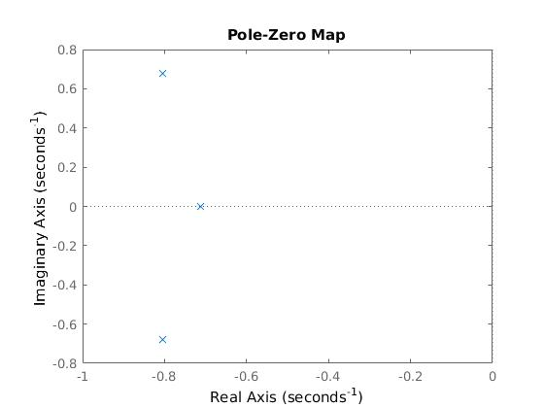
Dexter LQR Design
Cheap
Expensive

Slide 29
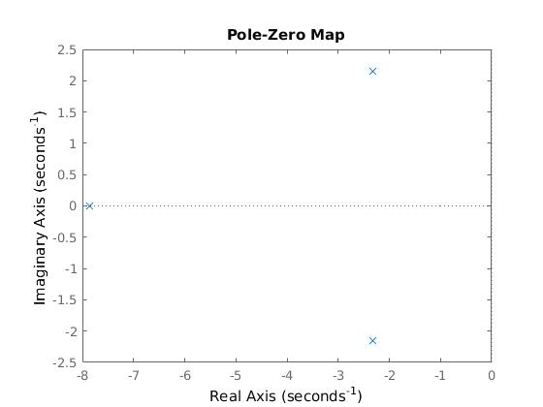
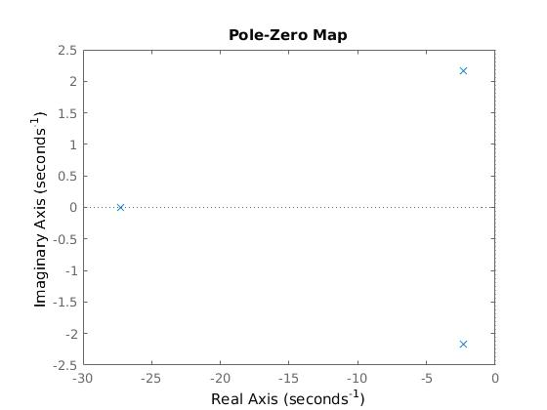
Dexter LQR Design
Equal
Diff Weights

Slide 30
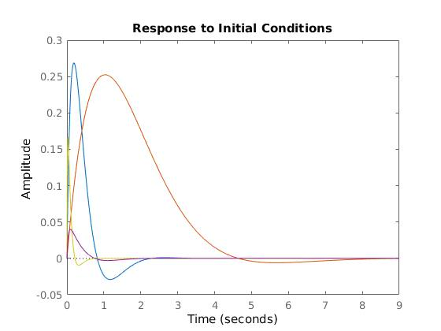
Dexter LQR Design
yellow - cheap
red - expensive
blue - equal
blue- different weighting for state_variables

Slide 31
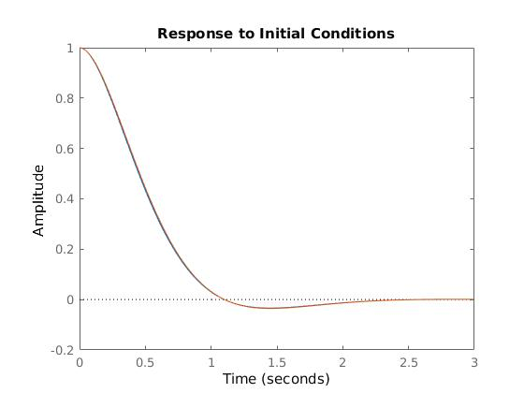
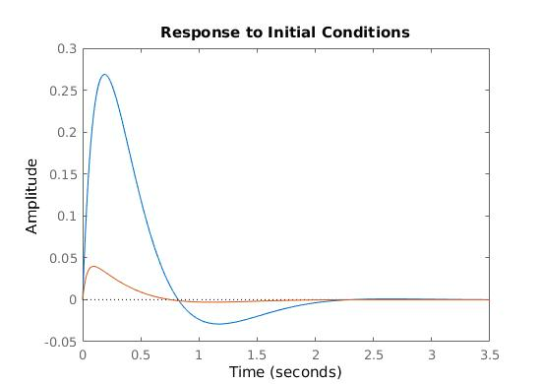
Dexter LQR Design
x1
xa

Slide 32
Future Work
Dexter
Implement the MIMO system on the raft. Determine how robust it is to the nonlinear damping of the surrounding fluid
Baxter
Determine how delays in system affect achievable range of impedances.

Slide 33
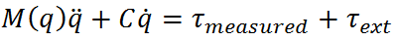
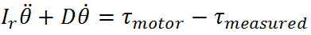
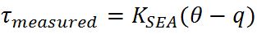
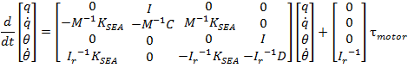
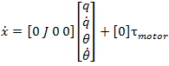
Appendix: Series Elastic Actuators: Open loop model
Equations of motion
State space representation

Slide 34
Appendix: Baxter Research Robot: Real System
Can achieve a fairly broad range of impedances using this approach.
There is a limit to how high the gains can be turned up that is not accounted for in this “simplified” model.
two likely reasons:
Delay in the system→ not a “state space” problem
The model does not account for all the dynamics of the system

Slide 35
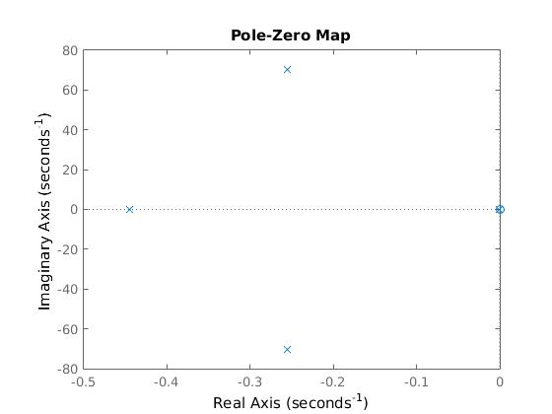

Appendix: Single SEA
Acts like a second order model until about 100 rad/s (far above Baxter’s operating frequency)
The second pair of poles not accounted for in the simplified model can still be driven into the RHP at high gains

Slide 36


Appendix: Series Elastic Actuators: Closed loop model

Slide 37
Turning a Non-Backdrivable Linear Actuator Into a Passive System
Creating a controller for the linear actuator based desired impedance parameters allows for:
A closed-loop system that promotes robust and stable interactions due to passivity
Achievable design constraints (e.g., Peak impact force, Settling time)
Definitive impedance values for Baxter to reproduce

Slide 38
Determining Desirable Impedance Characteristics
A reduction in peak force provides a buffer for a controller to react to any unforeseen collisions
Alleviates significant risks for valuable equipment on hard-to-reach AUVs
A sharp reduction in settling time suggests a smaller influence by external disturbances, such as underwater currents
Minimizes unpredictable disturbances during any on going contact tasks
Feed impedance values to Baxter!

Slide 39
Baxter Research Robot
For the purposes of the experiment, Baxter was constrained to planar motion by only allowing joints S1, E1, and W1 to move.

Slide 40
Baxter Research Robot: Open loop model
Neglecting SEA dynamics, Equations of Motion
Simplifies to
State space representation

Slide 41
Baxter Research Robot: Closed loop model

Slide 42
Baxter Research Robot: Real Data

Slide 43
Baxter Research Robot: LQR Design
What if we want to specify performance criteria for the states?
Max actuator force
Stroke Length
Use LQR to optimize performance and control effort

Slide 44
Baxter Research Robot: LQR Design
Bryson’s Rule
Baxter system criteria:
x1max (x position) = 0.5214 m
u1max (shoulder torque) = 50 Nm
u2max(elbow torque) = 15 Nm
u3max(wrist torque) = 15 Nm

Slide 45
Baxter Research Robot: LQR Design
Expensive vs Cheap Control
p = 1 (equal weighting)
p = 1e6 (expensive control)
p = 1e-6 (cheap control)

Slide 46
Baxter Research Robot: LQR Design
Open-Loop
Closed Loop: Equal Weighting

Slide 47
Baxter Research Robot: LQR Design
Closed Loop: Expensive
Closed Loop: Cheap

Slide 48
Baxter Research Robot: LQR Design
blue - cheap
orange - expensive
yellow - equal

Slide 49
Baxter Research Robot: LQR Discussion
Expensive control is realistic given good performance results and less control (actuator effort)
Choosing relative weighting of states/inputs may be significant
Can we design performance criteria around impact collision response?
Can we combine impedance into cost function for LQR design?

Slide 50
Dexter LQR Design
Criteria:
Max Thrust=10 Nm
Max Stroke length=10 in
Different Designs:
Cheap
Expensive
Equal
Weighting xa vs x1

Slide 51
Dexter LQR Design
Open-Loop

Slide 52
Dexter LQR Design
Cheap
Expensive

Slide 53
Dexter LQR Design
Equal
Diff Weights

Slide 54
Dexter LQR Design
yellow - cheap
red - expensive
blue - equal
blue- different weighting for state_variables

Slide 55
Dexter LQR Design
x1
xa

Slide 56
Future Work
Dexter
Implement the MIMO system on the raft. Determine how robust it is to the nonlinear damping of the surrounding fluid
Baxter
Determine how delays in system affect achievable range of impedances.

Slide 57
Appendix: Series Elastic Actuators: Open loop model
Equations of motion
State space representation

Slide 58
Appendix: Baxter Research Robot: Real System
Can achieve a fairly broad range of impedances using this approach.
There is a limit to how high the gains can be turned up that is not accounted for in this “simplified” model.
two likely reasons:
Delay in the system→ not a “state space” problem
The model does not account for all the dynamics of the system

Slide 59
Appendix: Single SEA
Acts like a second order model until about 100 rad/s (far above Baxter’s operating frequency)
The second pair of poles not accounted for in the simplified model can still be driven into the RHP at high gains

Slide 60
Appendix: Series Elastic Actuators: Closed loop model

